Slide 1
Module 1
Incident Basics
Incident Safety Team Training:
Incident Response Management & Resolution

Slide 2
Agenda
Objectives
Incident management at Akamai
Incidents and their 3 key concepts
Incident examples
Assessment
Review objectives
Feedback

Slide 3
Objectives
At the completion of this module,
you will be able to
Define an incident
Define and discuss the 3 key incident concepts: loss, hazard and safety constraint
Cite specific examples on incidents

Slide 4
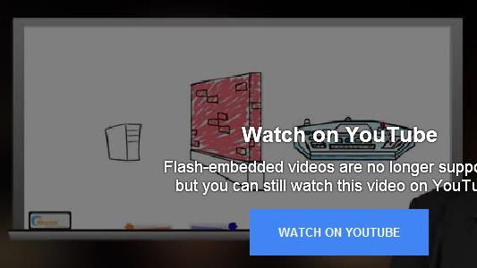
Incident Management at Akamai
At Akamai, incidents happen daily. Despite strong controls, it's inevitable that problems will arise when so much content is being handled, processed and distributed within Akamai and on behalf of customers. To deal with that reality, the company has a set of procedures to manage incidents as they materialize. Most incidents are resolved by small interventions in the network. In this whiteboard presentation, Bill Brenner gives an overview.

Slide 5
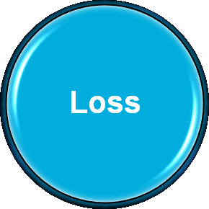
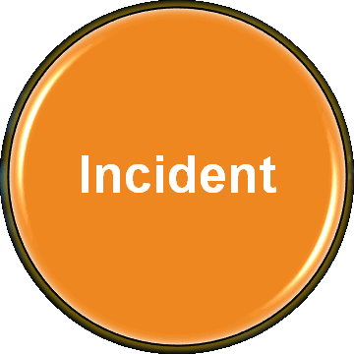
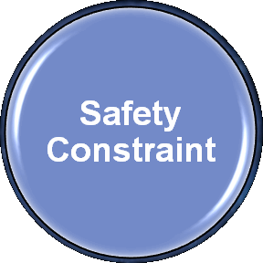
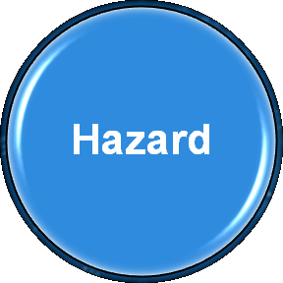
Key Concepts
Please click on a concept to learn more.

Slide 6
Incident
An incident is any urgent situation involving Akamai systems and processes that risks unacceptable loss for Akamai’s business or its customers.
3 key incident concepts to remember
Loss
Hazard
Safety constraint

Slide 7
Loss
A loss is the outcome we want to prevent or urgently mitigate, such as damage to human
life, property damage, negative customer or business impact. Losses occur when safety constraints are missing or poorly enforced,
allowing the system to drift into a hazard state. Incident response involves quickly and safely mitigating the loss, and determining and fixing
the hazards that led to the incident.

Slide 8
Hazard
A hazard is a combination of system and environmental conditions that can result in an incident, potentially leading to loss.

Slide 9
Safety Constraint
A safety constraint is technical or procedural controls that hold system operations within safe bounds.

Slide 10
Incident Examples
Examples of incidents include:
degradation or denial of service to customers;
discovery of a potential vulnerability;
any unplanned disruption to our ability to serve customers;
and unforeseen negative effects of a configuration change or software rollout.

Slide 11
Assessment
Which one is not a key incident concept?

Slide 12
Review Objectives
At the completion of this module,
you will be able to
Define an incident
Define and discuss the 3 key incident concepts: loss, hazard and safety constraint
Cite specific examples on incidents

Slide 13
Feedback
Congratulations on successfully completing this module! We would appreciate your feedback.
How would you rate the effectiveness of this module? (0 is not at all, 10 is very effective)
0 | 1 | 2 | 3 | 4 | 5 | 6 | 7 | 8 | 9 | 10

Slide 14
Feedback
If you could change anything, what would that be?

Slide 15
Feedback
If you have any other comments or suggestions, please enter them here.

Slide 16
Thank You!
Next up: Module 2

